Slide 1

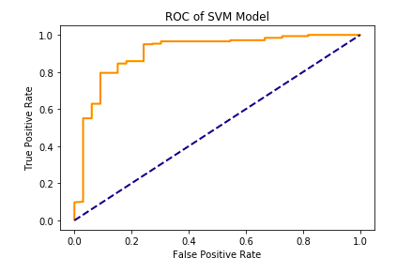
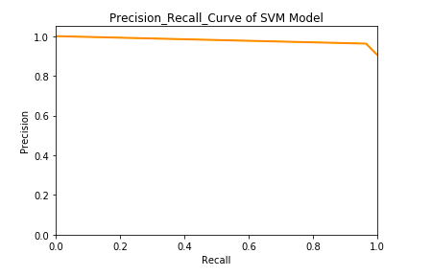
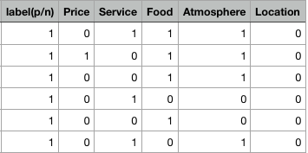
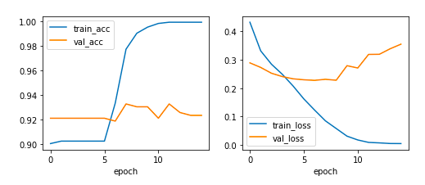
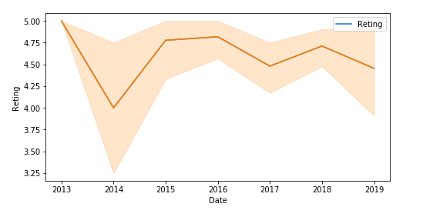
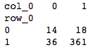
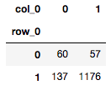
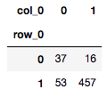
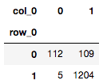
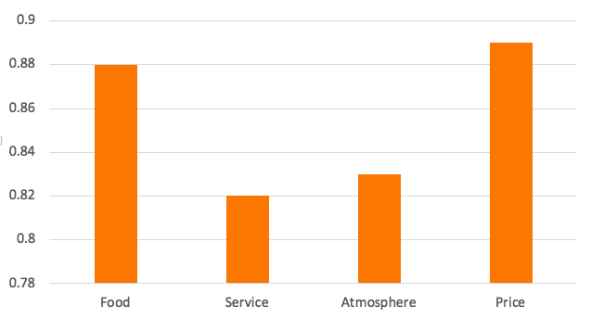
Groupon Review Analysis Students: Haitao Liu , Tianyu Liu, Jhao-Han Chen, Lingyao Kong Instructor: Rong Liu
Web Mining
Spring, 2019
Introduction
Find the advantages and drawbacks for each wine bar in New York City according to their customers’ rating and reviews.
Help the merchants have a better understanding of their wine bar and the aspects that need to be improved.
Find the relation between the rating score , rating count and reviews
Sentiment Analysis
Naïve Sentiment Analysis
We used the two dictionaries that contain positive and negative words to filter out the other words.
If more positive words than negative, then this review is positive.
If more positive words than negative, then this review is negative.
Supervised Sentiment Analysis
We chose Support Vector Machine as classifier and Tf-idf matrix as a feature. The ROC Curve and Precision-Recall Curve:
To measure accurately，we can also created a feature according to the rating score.(rating: >4 Positive,<4 Negative)
We can calculate the confusion matrix and accuracy according to the label
Convolutional Neural Networks
Training history:
Data Understanding
The data we used is base on 30 wine bars in New York City on the Groupon website including review, user, rating, date, rating count and review count
We manually labeled 1000 reviews(label P/N according to emotion of reviews and add four aspects of descriptions based on each sentence.
Exploratory Data Analysis
The tendency for the average rating in one store by year
The relation between the number of reviews or rating that each people has with their rating value:
The relation between the number of rating and the rating score
The word cloud shows that what kind of words appear most in each bars’ reviews
Method | SVM | Naïve Sentiment Analysis | Convolutional Neural Networks | Rating
AUC | 0.84 | 0.86 | 0.92 | 0.92
Confusion matrix
Prepare for the Reviews
Data Scraping and Cleaning:
We scraped all the data using python selenium webdriver, stored each wine bar in CSV file.
30 wine bars, 9000 reviews in total
Tokenization, involves splitting sentences and words from the body of the text. Remove Punctuations, Stopword, Emoji
Part of Speech Tagging:
We can find the specific aspects that get the positive or negative reviews.
Example:
Feature Extraction
Performed Multi-label classification on the aspects of the reviews
Classifier: SVM
Accuracy: 0.65
The accuracy in each aspect:

